Slide 1


Presentation to Senate
May 26, 2014
By Matt Milovick, VP – Administration & Finance

Slide 2
Context for the FY2014/15 Budget
Context for the FY2014/15 Budget
  Demographics
  AVED Funding
  Class Sizes
  Employee Costs
  Institutional Surplus
The FY2014/15 Budget
Question Period

Slide 3
Kindergarten and Grade 12 Enrolment Projections
School District 73 Kamloops/Thompson
Source:
Ministry of Education
Notes:
Our primary catchment area is trending towards stagnant enrolments into the future. Not anticipated to hit 2007 levels anytime soon.
As a planner and administrator, the signal for me is that TRU needs to plan for a plateauing of our on-campus enrolments. Growth will be augmented, somewhat by international enrolments (but those aspirations need to be tempered) as well as growth through the online environment.

Slide 4
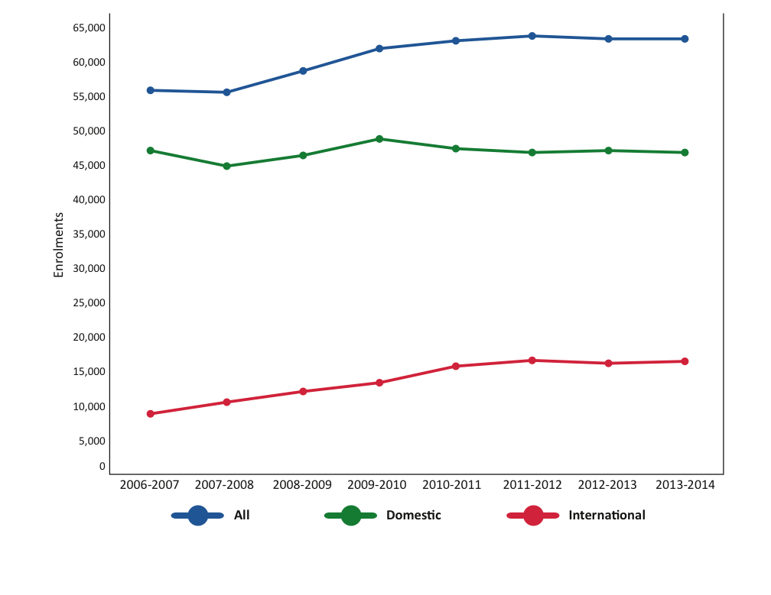
On-Campus Course Enrolments: 2006-2014
Notes:
If you look at the bottom red line, you can see a steady growth of international enrolments. By contrast, the green line shows that domestic enrolments on campus have declined slightly. The overall effect is essentially a plateauing of our on-campus enrolments. The decline in domestic enrolments have been negated by the increase in international enrolments.

Slide 5
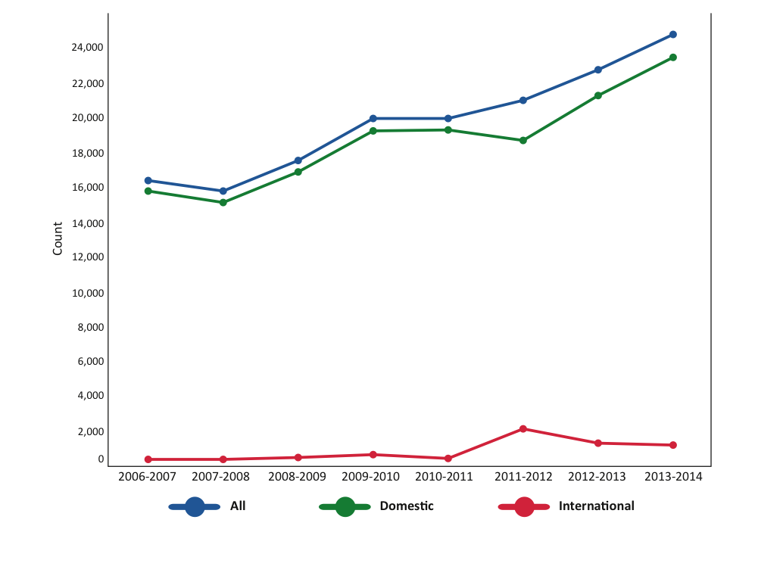
Open Learning Course Enrolments: 2006-2014
Notes:
In open learning, the story is the opposite. Since 2007/08, OL has seen steady growth domestically as evidenced by the green line. Growth in international enrolments in OL, as evidenced by the red line, peaked in 2011/12 and have declined slightly ever since. The overall effect is an overall growth of OL enrolments driven primarily by growth in domestic registrants.

Slide 6
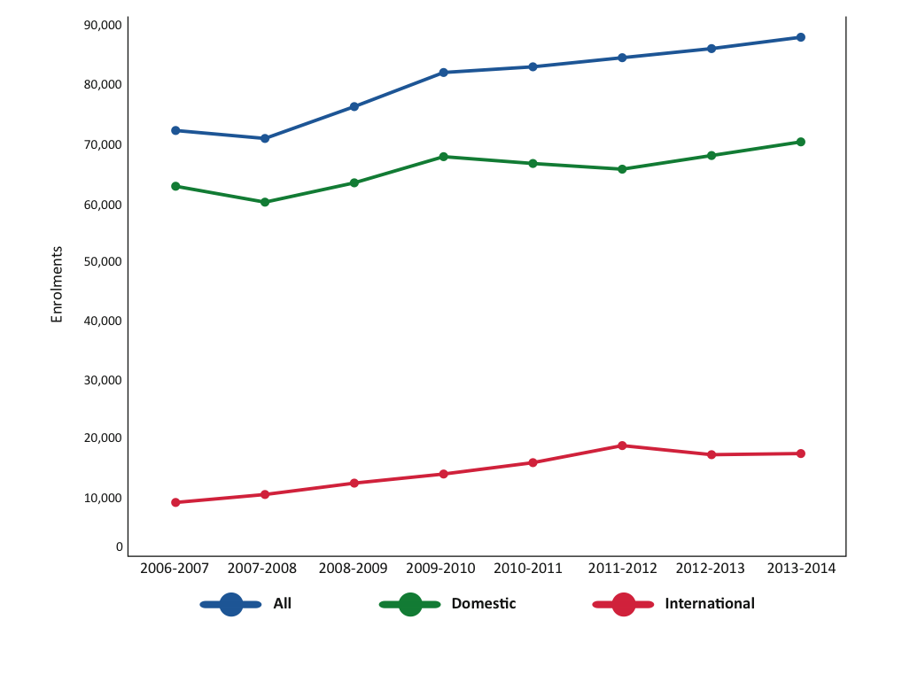
TRU Total Course Enrolments: 2006-2014
Growth Driven By OL/Int’l
Reliance on Int’l Growth is Risky
Notes:
To summarize the previous slides, overall enrolment is trending upwards because of the growth in international enrolments and open learning; offsetting the decline in domestic students on-campus.
International growth has offset the decline in domestic enrolments. Domestic enrolment trends are more predictable and allow institutions more time to adapt to changing conditions. International enrolments on the other hand are risky. As an example, we’ve developed strong markets in the Ukraine and Russia but with the political situation unfolding there, there is a high probability that we won’t see any students from that region (and we were anticipating about 100). Changes in currency, natural disasters, etc all have a bearing and we need to insulate ourselves as best we can against evolving circumstances.

Slide 7
AVED Government Grants ($000’s): 2010-2014
Trend in Declining Grants While Domestic
Enrolment Flat-Lines
Notes:
With those demographic trends in mind, lets look at the pattern of government grant funding. In this graph, you’ll notice that our government grant (in blue) has remained relatively flat while the Routine Capital Grant has been cut by more than 50% since 2010. The University has not been topped up for inflationary costs and with an aging infrastructure, pressures on that infrastructure continue to mount. This is a disturbing trend combined with the fact that we are limited in our ability to increase tuition revenues by the 2% maximum allowable by government.

Slide 8
Comparison of AVED Funded Block Grants
Notes:
Lowest Grant per FTE of all the RUCBC Universities ($1000/fte lower than UBC O).

Slide 9
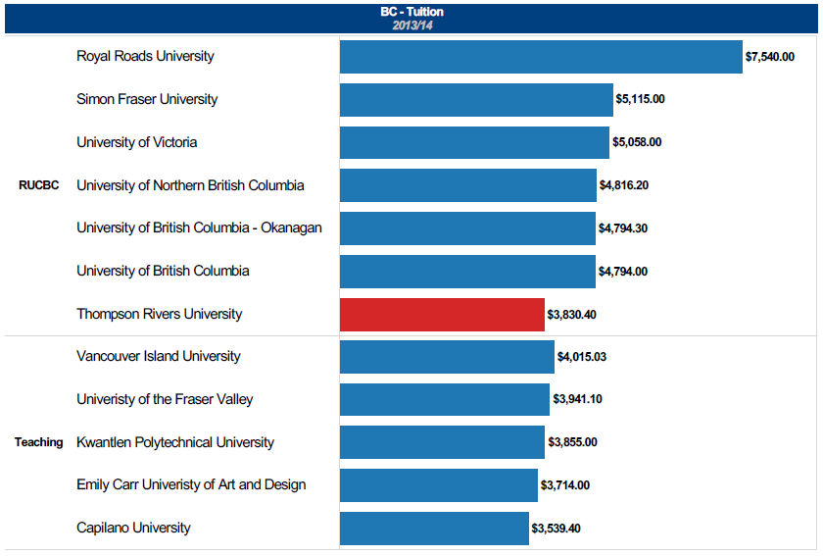
Tuition Fee Comparison (TRU and BC)

Slide 10
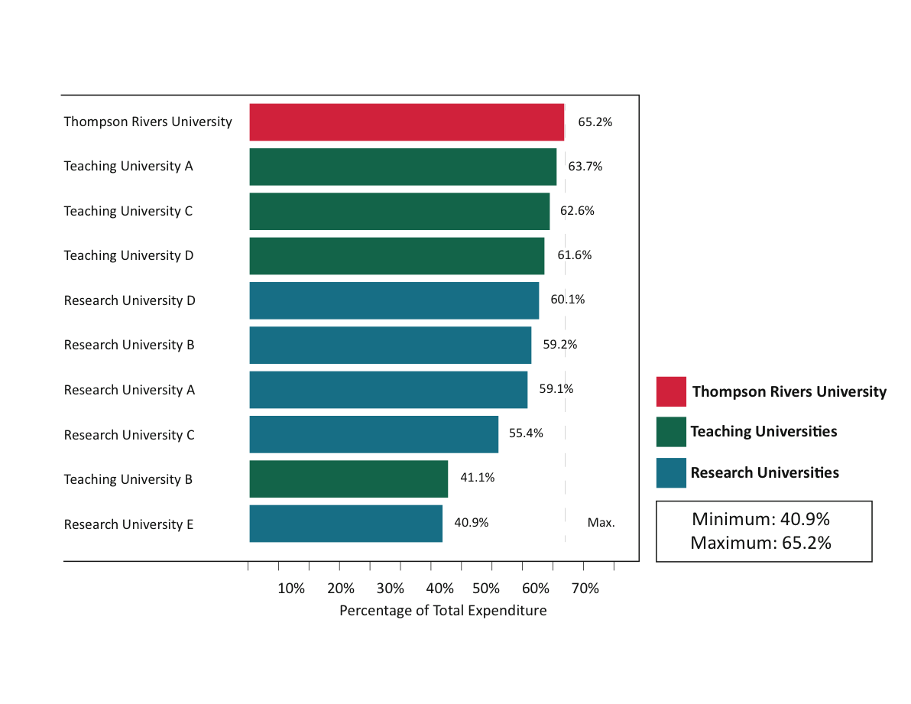
Academic Expenditure CAUBO Comparison
On Campus
Expenditures are as of 2011/12 CAUBO/ACPAU Report Comparison Benchmark Reports prepared by TRU Finance.
Notes:
So with flat enrolments and decreases in revenues, its important we understand how we spend our money.
Many of you have seen these graphs before. These graphs represent a comparison of TRU against BC Research Universities and Teaching Universities.
You’ll see from this, our percentage of total budget spent on academic expenditures (for on-campus students) is the highest in the province at 65.2%. Within this figure, CAUBO includes all costs attributable to academic faculties (the deans, associated deans, teaching costs, operating costs related to those faculties, etc). So I want to be clear this is not just the percentage spent on teaching.
The reason these comparisons are relevant is because all institutions reporting through CAUBO must report the same expenditures in the same buckets. So while we don’t know any one institution’s specific spend on teaching as a percentage of budget, these roll-ups are still apples-to-apples comparisons. Where most institutions spend the highest percentage of their budget on the activity of teaching, its fair to say that the comparison is a relevant and that TRU invests in teaching near the top end of the comparison pool.

Slide 11
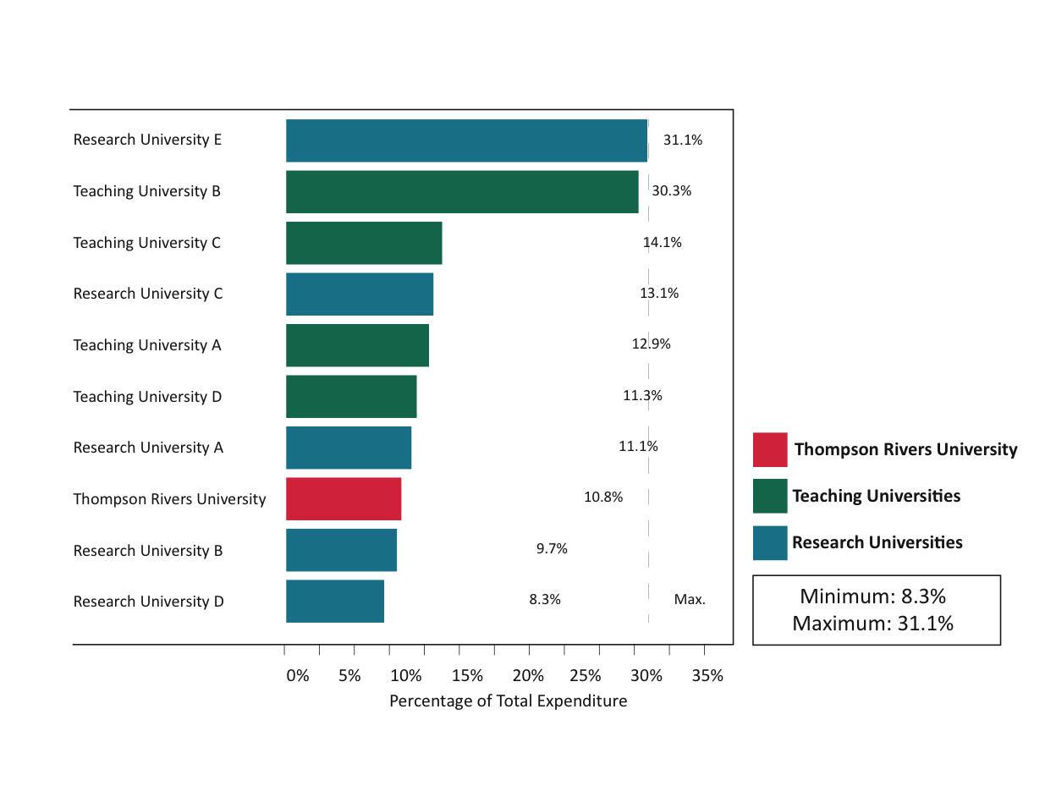
Administration & General Expenditure CAUBO Comparison
On Campus
Expenditures are as of 2011/12 CAUBO/ACPAU Report Comparison Benchmark Reports prepared by TRU Finance.
Notes:
By contrast, our spending on administration (e.g. non-academic administrative labour; financing costs; training and development, etc) is the third lowest in this comparative group.

Slide 12
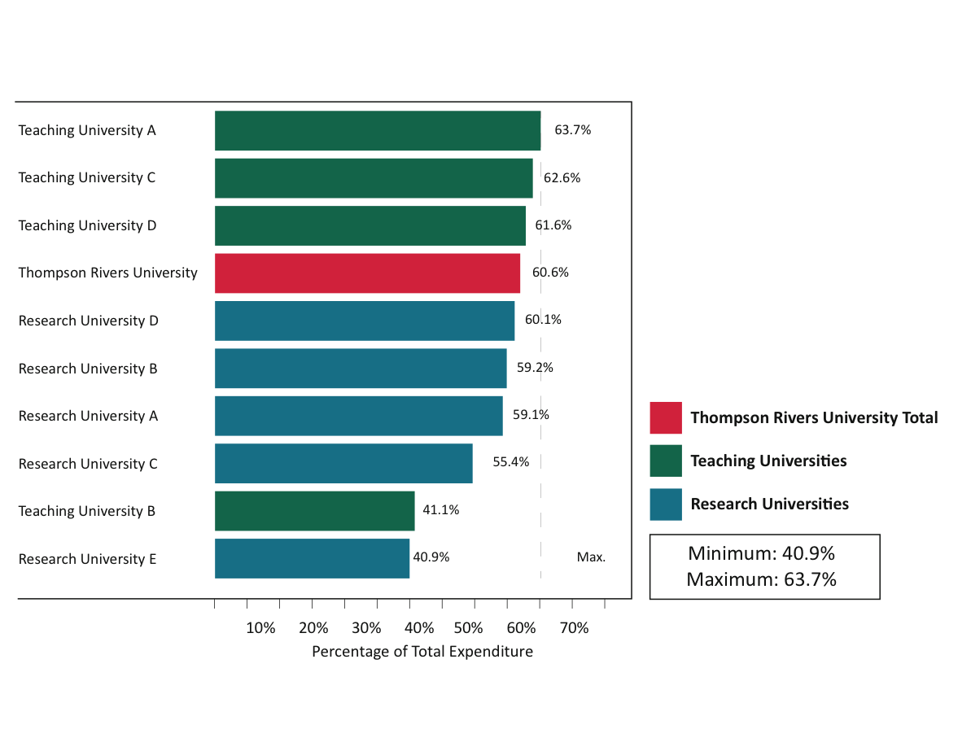
Academic Expenditure CAUBO Comparison
On Campus and OL
Notes:
If we include costs associated with open learning, which is heavy administratively our percentage spend on academics decreases – we’re still the highest ranked RUCBC university but we’re just slightly under 3 of the teaching universities in the province.

Slide 13
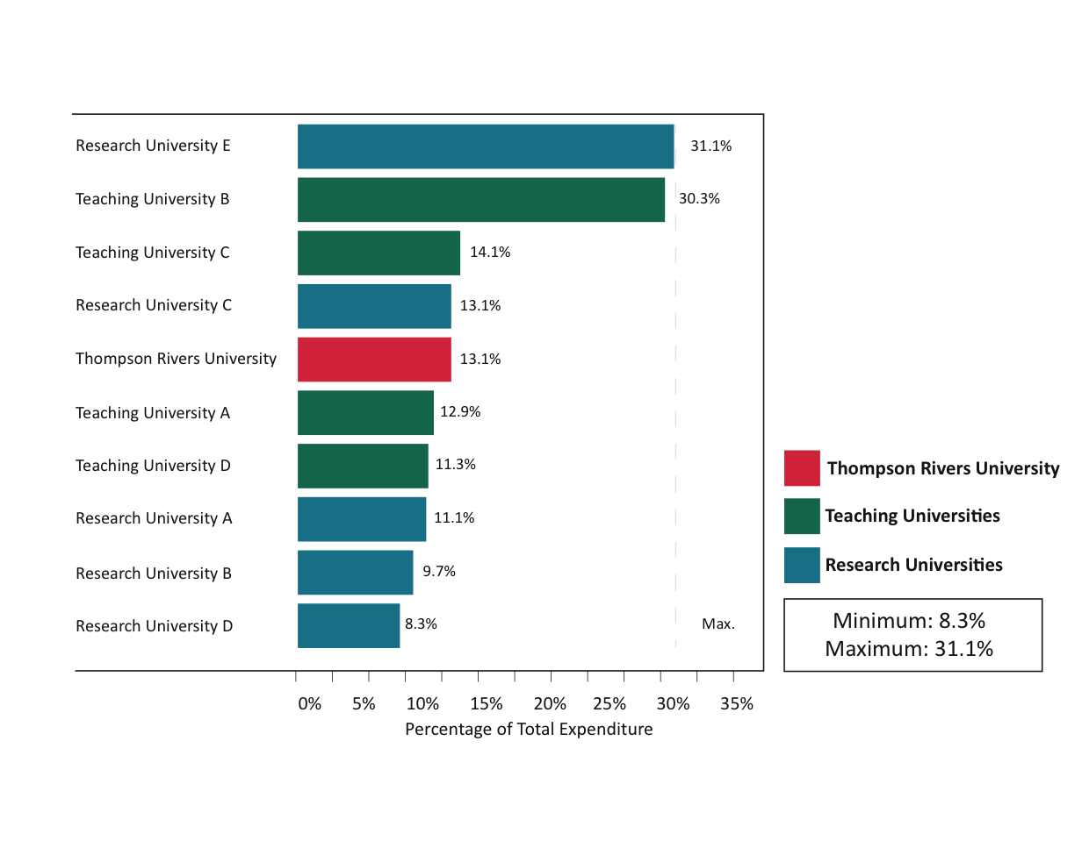
Administration & General Expenditure CAUBO Comparison
On Campus and OL
Notes:
Again, if we include open learning, our overall administrative spend increases slightly ranking us about middle of the pack.

Slide 14
Other Expense Categories CAUBO Comparison
 | ON CAMPUS | RANGE | RANK | OC & OL | RANGE | RANK
Student Services | 11.0% | 2.0-11.4% | 2/10 | 11.3% | 2.0-11.4% | 2/10
IT | 3.1% | 1.2-7.1% | 9/10 | 4.6% | 1.2-7.1% | 6/10
Physical Plant | 5.8% | 5.8-11.7% | 10/10 | 5.4% | 5.4-11.7% | 10/10
Library | 2.7% | 2.7-5.4% | 10/10 | 2.6% | 2.6-5.4% | 10/10
External Relations | 1.4% | 1.4-5.2% | 10/10 | 2.4% | 1.7-5.2% | 7/10

Slide 15
Average Fall Class Size: 2010-2013
Source: BC HEADset Submission
Notes:
So if you consider our academic expenditures; its not surprising that our average class sizes have consistently remained low. This data, taken from the Fall 2013 Space Utilization report shows that in 2013, first and second year classes averaged a class size of 23; and upper year classes averaged a class size of 19.
I should note these are academic class sizes so it excludes developmental and trades activity. For trades the maximum class sizes range from 16 to 18.

Slide 16
Historical Class Size Distribution: 2009-2013
Fall Semester, Kamloops Campus
Note: Compiled from annual internal Space Utilization reports.
Notes:
Considering the average class sizes of 23 for lower year and 19 for upper year; its interesting to note that the average class size falls into the “small class” category.
You can see the definition of small; medium and large classes in the legend below the graph.
What this means is that not only are the majority of our classes in the small category (less than 30); but the average class sizes of 23 and 19 are considerably lower than the small category cap of 29. Given that 36% of our classes are of the medium variety, and 9% are of the large variety, for average class sizes to be 23 and 19 in fall 2013 indicates that there are numerous sections considerably smaller than those averages.
What is also important to note is that by and large, the distribution of class sizes has not changed significantly since 2009.

Slide 17
Course Section Size Breakdown: Small Courses
20% of All Sections <15
Note. Only includes courses for academic credit. Excludes: co-op work terms, thesis courses, directed studies, or distance studies as identified in Banner.

Slide 18
All Employee Wages and Benefits ($’000’s) Relative to Course Enrolments: 2010-2014
Notes:
So lets move to our biggest expense category – employee costs.
The chart shows the trend of employee costs in each employment category. What we see is that the costs are steadily increasing in every employment class even though on-campus enrolments are declining. In 5 years, TRUFA costs have increased by $6.3M; Exempt by $4.5M; CUPE by $4.5M and TRUOLFA by $2M.
At the same time we’ve seen on-campus enrolments drop by 2,027 enrolments; while on-line has increased its enrolments by 5000 enrolments.
In 2014, the total salary cost to teach 1 on-campus enrolment was $892 and the average cost to teach 1 on-line enrolment was $233. Of course, you need to back out of that the TRUFA development costs and trades costs which aren’t captured in our academic enrolments. If you did, that number would be more like $700/OC enrolment
This is not sustainable in an environment where our enrolments are not increasing as fast as our costs..
So lets look at this data another way.

Slide 19
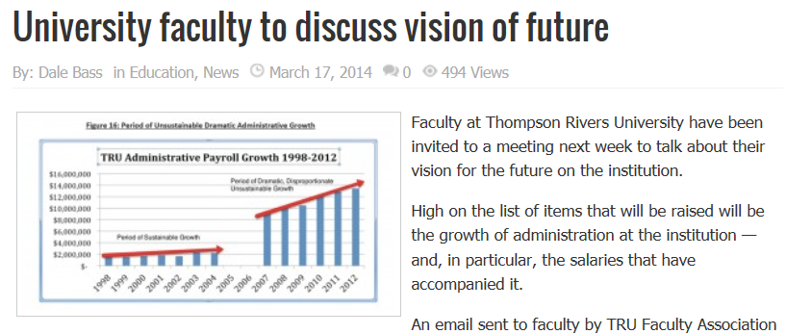
“Period of Dramatic, Disproportionate,
Unsustainable Growth”
Notes:
Some of you may recall this article from the Kamloops Daily news of March 17, 2014. The gist of the article was how administrative spending had gotten out of hand and the University was stockpiling surpluses at the expense of teaching and quality. The graph depicts, to the best of our knowledge, growth of the exempt (or admin) employee category. This graph only showed salary costs…the graph I showed you previously was much bigger because it included total compensation.
So in thinking about the caption – a period of “dramatic”, disproportionate, unsustainable growth”, I had to ask myself…is it?

Slide 20
All Employee Wages and Benefits ($’000’s) Relative to Course Enrolments: 2010-2014
Notes:
So the graph I showed you from the Kamloops this week, correlates specifically to the excluded category as seen here.

Slide 21
Percentage of Employee Category Costs Relative to Total TRU Employee Costs: 2010-2014
 | 2010 | 2011 | 2012 | 2013 | 2014 | 5yr Change
Exempt | 16.4% | 16.8% | 16.9% | 17.8% | 17.8% | 1.4%
TRUFA | 54.9% | 53.7% | 53.6% | 51.8% | 51.9% | (3.0)%
CUPE | 24.8% | 25.4% | 25.1% | 25.6% | 25.0% | 0.2%
TRUOLFA | 4.0% | 4.2% | 4.3% | 4.8% | 5.3% | 1.3%
TEACHING | 58.9% | 57.8% | 58.0% | 56.7% | 57.2% | (1.7%)
NON-TEACHING | 41.1% | 42.2% | 42.0% | 43.3% | 42.8% | 1.7%
Notes:
So let’s answer the dramatic, disproportionate, unsustainable growth question. This table shows the % of total compensation spent in each of the employment classes.
You’ll see since 2010, the exempt category has increased by 1.4%; CUPE has increased by 0.2% and TRUOLFA has increased by 1.3%. During that same period, total spending as a percentage of compensation budget has decreased by 3.0% in TRUFA.
If you take the universities teaching costs as an aggregate, you’ll see that the % spent on teaching has declined slightly by 1.7% and the increases in non-teaching have increased by the corresponding amount. But again, in real dollar terms, all employee categories have increased.
Is this dramatic…no. Is it disproportionate – no. Actual dollars spent in each employee class have increased whereas the amounts spent as a percentage of budgets have changed only slightly so there’s nothing dramatic or disproportionate in any of these findings. However, with respect to the question of sustainable, given how our enrolments are trending, these trends are not sustainable and we need to really begin to question our costs in all areas of the university.

Slide 22
Employee Headcounts: 2010-2014
 | 2010 | 2011 | 2012 | 2013 | 2014 | 5yr Change
Exempt | 137 | 149 | 160 | 172 | 156 | 12.2%
TRUFA | 433 | 421 | 410 | 413 | 404 | (6.7)%
CUPE | 349 | 346 | 344 | 355 | 362 | 3.7%
TRUOLFA | 128 | 133 | 186 | 195 | 193 | 50.8%
TEACHING | 53.6% | 52.85 | 54.2% | 53.6% | 53.5% | (0.1)%
NON-TEACHING | 46.4% | 47.2% | 45.8% | 46.4% | 46.5% | 0.1%
Notes:
We’ve looked at the proportions from a financial perspective so lets explore them from an employee headcount perspective.
Is this dramatic…no. Is it disproportionate – no. Actual dollars spent in each employee class have increased whereas the amounts spent as a percentage of budgets have changed only slightly so there’s nothing dramatic or disproportionate in any of these findings. However, with respect to the question of sustainable, given how our enrolments are trending, these trends are not sustainable and we need to really begin to question our costs in all areas of the university.

Slide 23
Excluded Wages and Benefits (‘000’s): 2005-2014
The Moment The World Changed
Notes:
One other quick observation that was made when we did the analysis is that we took the total compensation for the exempt category and we graphed the costs of the employees based on where they were assigned.
So you can see that we’ve split out the academic divisions (which includes library, student services, reg office, faculties, provost, etc) open learning division, law, etc.
What’s interesting is you can see a distinct change in spending behaviour at the time of the current budget methodology was installed. What happened here is that the operating budget of the administrative units were increased and budget managers spent to the level of those increases and basically maintained that level of spend over time since their budgets didn’t change substantially. On the academic side, we see a steady increase in administrative spending because Deans now had the ability to spend as their tuition revenues grew. There are other factors here of course but the timing of this change in spending patterns is really interesting and in some ways speaks to how the current budget methodology gave budget manager the ability to spend on whatever they felt was important because they had the resources to do so.

Slide 24
Average Salary by Employee Group: 2010-2014
Notes:
This chart shows how the average salary of an employee in each category has changed over the past 5 years.
Taken together, the average salary of all employees has increase 9.85% since 2010.
By employee category; the average exempt salary has increased by 7%; the average TRUFA salary increased by 11%; the average CUPE salary increased by 10% and the average TRUOLFA salary increased by 13%

Slide 25
Employee Category Salary Increases: 2010-2014
 | 2010 | 2011 | 2012 | 2013 | 2014
General Wage Increase
Exempt | 2.0% | 0.0% | 0.0% | 0.0% | 0.0%
TRUFA | 2.5% | 0.0% | 0.0% | 2.0% | 2.0%
CUPE | 2.0% | 0.0% | 0.0% | 2.0% | 2.0%
TRUOLFA | 3.0% | 0.0% | 0.0% | 2.0% | 2.0%
Progression Through the Scale
Exempt | 0.0% | 0.0% | 0.0% | 0.0% | 0.0%
TRUFA | 3.0% | 3.0% | 3.0% | 3.0% | 3.0%
CUPE | 0.0% | 0.0% | 0.0% | 0.0% | 0.0%
TRUOLFA | 0.0% | 0.0% | 0.0% | 0.0% | 0.0%
Notes:
When you look at the employee category collective agreement increases; the previous slide begins to make more sense.

Slide 26
Employee Category Average Salaries: 2010-2014
 | 2010 | 2011 | 2012 | 2013 | 2014 | 5 Yr Change
Exempt | $82,918 | $85,566 | $86,211 | $86,103 | $88,916 | 7.2%
TRUFA | $79,312 | $81,489 | $83,176 | $84,428 | $88,402 | 11.5%
CUPE | $43,511 | $43,288 | $44,302 | $46,804 | $48,060 | 10.5%
TRUOLFA | $20,286 | $21,753 | $17,656 | $19,486 | $22,905 | 12.9%
Notes:
When you look at the employee category collective agreement increases; the previous slide begins to make more sense.

Slide 27
Annual Surplus: 2010-2014
Annual Surplus Trending Downward
Hey! We were projecting a deficit!!
What happened??

Slide 28
Mitigating the Deficit – How We ALL Did It
Increased Tuition Revenue | $1.0M | Continuing studies and trades ($0.9M)
Increased Internal Revenues | $0.8M | All interfund transfers (parking, ancillary)
All Other Revenues Net | $0.3M | All other minor revenue increases
Reduced Total Compensation | $1.3M | Reduced Spending by Faculties/Units
Reduced Carry-Forward Spending | $0.6M | Reduced Spending by Faculties
All Other Expenditures (net) | $0.2M | Reduction of General Expenditures Faculties/Units
Actual Operating Results | $4.2M
Non-Operating Fund | $1.6M | Reduction in amortization ($0.7M) and deferral of Ancillary renovation ($0.9)
Other Non-Operating Fund | ($0.4)M | Other cost fluctuations in Non-Operating
Actual Non-Operating Results | $1.2M
Total Change from Q3 Forecasted Deficit | $5.4M
Q3 Total Forecasted Deficit | $(1.2)M
FY 2013/14 Surplus | $4.2M
Notes:
Faculties were still $1MM overspent at year end.

Slide 29
5 Year Annual Trend: Accumulated Surplus
Accumulated Surplus Trending Upward

Slide 30
Accumulated Surpluses ($‘000’s): 2010-2014
 | 2010 | 2011 | 2012 | 2013 | 2014
Invested in Fixed Assets | $14.7 | $15.5 | $21.3 | $30.8 | $36.0
Internally Restricted | $20.5 | $21.2 | $30.7 | $24.1 | $25.4
Restricted for Endowments | $0.7 | $0.7 | $0.7 | $0.7 | $0.7
Accumulated Re-measurement Gains/Losses | $0.0 | $0.0 | $0.0 | $0.4 | $(0.1)
Unrestricted Surplus | $9.4 | $16.6 | $18.6 | $19.7 | $17.3
Accumulated Surplus | $45.3 | $54.0 | $71.3 | $75.7 | $79.3
Available Cash

Slide 31
Interest Income: 2010-2014
Redistributed in the Block Grant

Slide 32
The FY2014/15 Budget
TRU’s Consolidated Budget Structure
Overall Operating Revenues
Overall Operating Expenses
Budget Breakdown by Executive Portfolio
Capital Fund Budget
Ancillary Services Budget
Sponsored Research Budget
Specific Purpose Budget

Slide 33
TRU’s All Funds Budget Structure
Consolidated
(All Funds)
Operating Fund
Capital Fund
Ancillary Services Fund
Sponsored Research Fund
Specific Purpose Fund

Slide 34
Consolidated (All Funds) Budget FY2014/15
 |  | Operating Fund | Non Operating Funds |  |  |  |  |  |  | CONSOLIDATED
 |  | Annual Budget | Professional Allowance | Ancillary Services | Capital | Specific Purpose | Bursaries | Research | Sub-Total Budget | Total Budget
Total Revenue |  | $140,130,000 | $698,000 | $16,791,007 | $10,190,000 | $4,463,309 | $1,280,000 | $3,131,000 | $36,553,316 | $176,683,316
Total Expenditures |  | $136,021,000 | $576,500 | $17,009,344 | $10,157,000 | $4,849,709 | $1,280,000 | $3,131,000 | $37,003,553 | $173,024,553
Excess (Deficiency) of Revenues over Expenditures before Reserves and Purchase of Capital Assets |  | $4,109,000 | $121,500 | $(218,337) | $33,000 | $(386,400) | - | - | $(450,237) | $3,658,763
 | Purchase of Capital Assets |  |  |  | $947,000 |  |  |  | $947,000 | $947,000
 | Building Reserves |  |  |  | $1,480,000 |  |  |  | $1,480,000 | $1,480,000
 | Board Reserves | $1,900,000 |  |  |  |  |  |  |  | $1,900,000
Reserves/Purchase of Capital Assets |  | $1,900,000 | - | - | $2,427,000 | - | - | - | $2,427,000 | $4,327,000
Fund Surplus (Deficiency) after Reserves |  | $2,209,000 | $121,500 | $(218,337) | $(2,394,000) | $(386,400) | - | - | $(2,877,237) | $(668,237)
Notes:
$688,

Slide 35
Operating Fund
Revenue Assumptions – FY2014/15
ASSUMPTION | +/- vs FY13/14 | RISK | NOTES
Government Grants | -$1,639,000 |  | $698,131 reduction from AVED; $939,000 OTO funding adjustments in Allied Health and Trades
Tuition – Domestic On-Campus Enrolments | -$100,000 |  | Elimination of 3-yr rolling average Slight decrease in on-campus domestic enrolment projected
Tuition – Domestic Tuition Fee Increase | $400,000 |  | 2% increase as per AVED mandate (assuming approval by BOG)
Tuition - Continuing Studies | -$1,400,000 |  | Trades c/s budget forecast reduction
Tuition – Law School | $1,000,000 |  | Based on a fall enrolment of 110 for the 2014 cohort (includes 2% fee increase)
Tuition – Open Learning | $1,200,000 |  | Estimating 14% revenue growth (includes 2% fee increase)
Tuition – International | $1,900,000 |  | Increase of $700k from second year of approved fee increase Grad tuition expected to increase by $1.2MM, mostly in SoBE
Lab and Course Fees | $200,000 |  | 2% increase as per AVED mandate (assuming approval by BOG)
Interest Revenue | -$312,000 |  | Expecting lower returns on investments in 2014/15
Internal Transfers | -$2,000,000 |  | OTO transfer’s that will not occur in 2014/15 Transfer of $950k to capital fund
Notes:
Budget to Actual – because of the change to 3 yr rolling average

Slide 36

Operating Fund
Revenue Comparison - % of Total Operating Budget

Slide 37
Operating Fund
Revenue Comparison – Dollars
12% ∆
(9)% ∆
15% ∆
0% ∆
6% ∆
(2)% ∆
Notes:
Total Operating Revenue Increase of 1% yr/yr

Slide 38
Operating Fund
Expense Assumptions FY2014/15
ASSUMPTION | +/- vs FY2013/14 | RISK | NOTES
Compensation & Benefits | -$255,000 |  | Assumes 0% general wage increase for 2014/15 Progression and promotion increases offset by decreases to divisional budgets to account for lower tuition revenue
Benefit Expense | $600,000 |  | Increase confirmed by benefit provider
Open Learning – Compensation Costs | $1,000,000 |  | Addition tuition revenue of $1.2MM attracts additional teaching costs
Institutional Issues – Contingency | $761,000 |  | Amount set aside for institutional issues
Strategic Reinvestment | $362,000 |  | Amount for strategic reinvestment as per three year plan (2012/13 to 2014/15)
Equipment Allocation | -$950,000 |  | Transferred to Capital Fund for 2014/15
General | -$1,248,000 |  | AVED does not fund inflationary or non-salary increases Non-salary expenditures have been adjusted for target reduction and deficit elimination plans for all divisions

Slide 39
Operating Fund
Expense Comparison - % of Total Operating Budget

Slide 40
Operating Fund
Expense Categories/Comparisons
104% ∆
0% ∆
2% ∆
13% ∆
Notes:
Expenditures are flat – essentially the same level as last year.

Slide 41
Operating Fund
Expense Breakdown By Executive Portfolio
 |  | 2014/15 Budget | 2013/14 Budget | % Change | 2013/14 Actual | 2013/14 Surplus/Deficit
VP Academic and Provost Total |  | $ 92,900,265 | $ 95,415,847 | -2.64% | $ 96,435,270 | $ 210,712
VP Administration and Finance Total |  | $ 25,655,076 | $ 24,891,146 | 3.1% | $ 25,925,032 | $ 289,335
VP Advancement Total |  | $ 941,608 | $ 985,075 | -4.4% | $ 1,050,984 | $ 21,365
President & Vice-Chancellor Total* |  | $ 11,774,293 | $ 12,327,030 | -4.5% | $ 11,820,672 | $ 1,269,691
Institutional |  | $ 4,749,758 | $ 2,696,768 | 76.13% | $ 1,123,871 | $ 3,300,573
Total Operating Expenditures |  | $ 136,021,000 | $ 136,315,866 | -1.8% | $ 136,355,829 | $ 5,091,676
* TRU World rolls up to the President & Vice-Chancellor but reports to Provost (academics) and VP-AF (operations)
Notes:
Institutional – credit card fees; institutional portions of total comp (e.g. we don’t assign to the divisions); institutional contracts (e.g. PSA’s); differences between benefits (allocation method to the benefits – plug goes to institutional); institutional transfers (e.g. capital transfers, dif between international tuitions and the allocations – any expense or revenue not attributable to a division – e.g. copyright); institutional computer expenses; banking and interest charges; audit fees
Institutional % Change: Strategic Initiatives and Institutional Issues have not been allocated to divisions ($1.12M); Unallocated benefit increase; budget increase for bank, interest & Credit Card Fees ($400k)

Slide 42
Operating Fund
Expense Breakdown By Executive Portfolio
VP ACADEMIC & PROVOST
 |  |  | 2014/15 Budget | 2013/14 Budget | % Change | 2013/14 Actual Exp. | 2013/14 Surplus/Deficit
VP Academic and Provost Roll-Up
 | Faculty of Science |  | $13,103,639 | $13,145,708 | -0.3% | $13,733,442 | $(215,690)
 | School of Business and Economics |  | $7,264,465 | $7,476,628 | -2.8% | $7,628,785 | $(502,855)
 | Faculty of Human, Social & Education Development |  | $8,694,330 | $9,957,411 | -12.7% | $9,240,586 | $55,050
 | School of Nursing |  | $5,091,778 | $4,944,582 | 3.0% | $5,111,136 | $(63,679)
 | Faculty of Adventure, Culinary Arts & Tourism |  | $4,529,314 | $4,167,745 | 8.7% | $4,770,176 | $129,607
 | Faculty of Arts |  | $10,303,173 | $10,345,918 | -0.4% | $10,548,792 | $(227,297)
 | Faculty of Law |  | $4,485,376 | $4,709,484 | -4.8% | $4,757,305 | $(590,826)
 | School of Trades & Technology |  | $6,364,392 | $8,625,874 | -26.2% | $8,222,372 | $422,349
 | University Library |  | $2,890,419 | $2,914,496 | -0.8% | $2,651,960 | $273,343
 | AVP Strategic Enrolment & Registrar |  | $7,235,544 | $7,799,720 | -7.2% | $7,953,520 | $133,180
 | Centre for Student Engagement & Learning Innovation |  | $568,806
 | CommunityU* |  | $1,794,300 | $2,451,630 | -26.8% | $2,885,672 | $185,168
 | AVP Research and Graduate Studies |  | $848,238 | $714,976 | 18.6% | $677,082 | $10,428
 | Open Learning |  | $17,283,221 | $15,983,128 | 8.1% | $16,068,802 | $955,261
 | VP Academic and Provost |  | $2,443,270 | $2,178,547 | 12.2% | $2,185,640 | $(353,327)
VP Academic and Provost Total |  |  | $92,900,265 | $95,415,847 | -2.64% | $96,435,270 | $210,712
* CommunityU has a dual reporting line to the Provost (academics) and VP-AF (operations)
Notes:
Elimination of 3-yr rolling average

Slide 43
Operating Fund
Expense Breakdown By Executive Portfolio
VP-ADMINISTRATION & FINANCE
 |  | 2014/15 Budget | 2013/14 Budget | % Change | 2013/14 Actual Exp. | 2013/14 Surplus/Deficit
VP Finance & Administration Roll-up
 | Environment & Sustainability | $376,855 | $217,704 | 73.1% | $302,744 | $23,703
 | Facilities | $5,776,065 | $5,308,251 | 8.8% | $6,172,101 | $(130,291)
 | Williams Lake* | $4,465,182 | $4,556,607 | -2.0% | $4,456,974 | $73,783
 | Athletics & Recreation | $1,888,363 | $1,904,215 | -0.8% | $2,122,272 | $3,978
 | AVP IT Services | $4,666,996 | $4,825,500 | -3.3% | $4,988,947 | $(46,186)
 | AVP HR & Planning | $3,404,000 | $2,617,842 | 30.0% | $2,604,629 | $106,393
 | AVP Finance | $3,661,637 | $3,359,027 | 9.0% | $3,269,950 | $216,878
 | Budget Development & Audit | $165,992 | $248,427 | -33.2% | 249,094 | $2,787
 | VP Finance & Administration | $1,249,986 | $1,853,573 | -32.6% | $1,758,321 | $38,290
VP Finance & Administration Total |  | $25,655,076 | $24,891,146 | 3.1% | $25,925,032 | $289,335
* Williams Lake has a dual reporting line to the Provost (academics) and VP-AF (operations)
Notes:
E&S – Carbon Taxes from VP-AF to E&S
Facilities – Includes estimates for IDI revs and exp not budgeted for in previous years (trying to provide a more complete picture)
AVP HR – Search costs and retirement allowances and funding for Benefits Officer
Budget Dev – portion to Finance
AVP Fin – portion from Budget Dev and from OL

Slide 44
Operating Fund
Expense Breakdown By Executive Portfolio
VP ADVANCEMENT & PRESIDENT
 |  | 2014/15 Budget | 2013/14 Budget | % Change | 2013/14 Actual Exp. | 2013/14 Surplus/Deficit
VP Advancement Total |  | $941,608 | $985,075 | -4.4% | $1,050,984 | $21,365
President & Vice-Chancellor Roll-Up
 | President | $624,119 | $634,901 | -1.7% | $646,164 | $(10,179)
 | TRU Secretariat | $802,563 | $814,815 | -1.5% | $773,779 | 41,618
 | Aboriginal Affairs | $356,097 | $598,349 | -40.5% | $657,365 | $(83,861)
 | TRU World* | $9,047,000 | $9,353,000 | -3.3% | $8,678,878 | $1,379,007
 | AVP Marketing & Communications | $944,514 | $925,965 | 2.0% | $1,064,486 | $(56,894)
President & Vice-Chancellor Total |  | $11,774,293 | $12,327,030 | -4% | $11,820,672 | $ 1,269,691
* TRU World rolls up to the President & Vice-Chancellor but reports to Provost (academics) and VP-AF (operations)

Slide 45
Budget FY2014/15 - Conclusions
Operating Budget accounts for 78.% of all expenditures in the Consolidated Budget
Total Compensation accounts for 64% of all Consolidated Expenditures (76.6% of the Operating Budget)
Flat Operating Revenues/Operating Expenses
Operating Budget Surplus of $2.2MM
Consolidated Budget Deficit of $668k
Achievement dependent upon prudent management

Slide 46
Questions?

Slide 47
Operating Fund
Appendix I: Operating Fund Budget
 |  | Operating Fund
Revenue
 | Government Grants | $68,325,000
 | Tuition - Domestic | $34,067,000
 | Tuition - International | $29,067,000
 | Lab and Course Fees | $6,100,000
 | Interest Revenue | $2,026,000
 | Other Revenues and Sales | $3,922,000
 | International Building Levy | $(3,000,000)
 | Internal Revenues and Transfers | $(377,000)
Total Revenue |  | $140,130,000
Expenditures
 | Compensation and Benefits | $104,172,000
 | Strategic Initiatives | $362,000
 | Institutional Issues - Contingency | $761,000
 | Operating Supplies | $5,766,000
 | Professional Fees and Contracted Services | $10,026,000
 | Building, Equipment, Operations and Maintenance | $6,240,000
 | Travel, Membership and Training | $3,295,000
 | Advertising, Promotion and Recruitment | $2,265,000
 | Bursaries, Awards and Scholarships | $1,084,000
 | Computer, Technology Leasing and Upgrades | $698,000
 | Interest, Bank and Credit Card Charges | $1,352,000
Total Expenditures |  | $136,021,000
Excess (Deficiency) of Revenues over Expenditures before Reserves and Purchase of Capital Assets |  | $4,109,000
 | Purchase of Capital Assets
 | Building Reserves
 | Board Reserves | $1,900,000
Reserves/Purchase of Capital Assets |  | $1,900,000
Fund Surplus (Deficiency) after Reserves |  | $2,209,000

Slide 48
Capital Fund
Appendix 2 - Capital Fund Budget
 |  | Non Operating Funds
 |  | Capital
Revenue
 | Government Grants | $815,000
 | Lab and Course Fees | $900,000
 | Interest Revenue | $252,000
 | Other Revenues and Sales | $131,000
 | International Building Levy | $3,000,000
 | Internal Revenues and Transfers | $592,000
 | Amortization of Deferred Capital Assets | $4,500,000
Total Revenue |  | $10,190,000
Expenditures
 | Compensation and Benefits | $37,000
 | Operating Supplies | $25,000
 | Professional Fees and Contracted Services | $453,000
 | Building, Equipment, Operations and Maintenance | $1,550,000
 | Interest, Bank and Credit Card Charges | $507,000
 | Amortization of Capital Assets | $7,585,000
Total Expenditures |  | $10,157,000
Excess (Deficiency) of Revenues over Expenditures before Reserves and Purchase of Capital Assets |  | $33,000
 | Purchase of Capital Assets | $947,000
 | Building Reserves | $1,480,000
 | Board Reserves
Reserves/Purchase of Capital Assets |  | $2,427,000
Fund Surplus (Deficiency) after Reserves |  | $(2,394,000)
Notes:
Capital fund: Capital fund records the recognition of revenues designated for capital projects and expenditures including amortization of assets, interest on debt relating to capital construction, and other expenditures relating to buildings and equipment.

Slide 49
Ancillary Services Fund
Appendix III - Ancillary Services Fund Budget
 |  | Non Operating Funds
 |  | Ancillary Services
Revenue
 | Lab and Course Fees | $75,000
 | Other Revenues and Sales | $17,896,716
 | Internal Revenues and Transfers | $(1,180,709)
 | Amortization of Deferred Capital Assets | -
Total Revenue |  | $16,791,007
Expenditures
 | Compensation and Benefits | $2,732,421
 | Operating Supplies | $1,382,959
 | Inventory & Cost of Goods Sold | $5,989,400
 | Professional Fees and Contracted Services | $1,228,117
 | Building, Equipment, Operations and Maintenance | $1,956,745
 | Travel, Membership and Training | $82,279
 | Advertising, Promotion and Recruitment | $87,070
 | Computer, Technology Leasing and Upgrades | $4,100
 | Interest, Bank and Credit Card Charges | $2,194,921
 | Amortization of Capital Assets | $1,351,332
Total Expenditures |  | $17,009,344
Excess (Deficiency) of Revenues over Expenditures before Reserves and Purchase of Capital Assets |  | $(218,337)
 | Purchase of Capital Assets
 | Building Reserves
 | Board Reserves
Reserves/Purchase of Capital Assets |  | -
Fund Surplus (Deficiency) after Reserves |  | $(218,337)
Notes:
Ancillary fund: Ancillary enterprises (retail sales and services) provide retail goods and services to the University community and include: the bookstores, Culinary Arts operations, parking services, contracted food and beverage services, conference and convention activities, student residence and printing services.
$1.2 from parking to operating
Residence only – CAC amortized under

Slide 50
Sponsored Research Fund
Appendix IV -Sponsored Research Fund Budget
 |  |  | Non Operating Funds
 |  |  | Research
Revenue
 | Government Grants |  | $2,900,000
 | Interest Revenue |  | $100,000
 | Other Revenues and Sales |  | $177,000
 | Internal Revenues and Transfers |  | $(46,000)
Total Revenue |  |  | 3,131,000
Expenditures
 | Compensation and Benefits |  | $1,300,000
 | Operating Supplies |  | $235,000
 | Inventory & Cost of Goods Sold |  | $24,000
 | Professional Fees and Contracted Services |  | $400,000
 | Building, Equipment, Operations and Maintenance |  | $342,000
 | Travel, Membership and Training |  | $400,000
 | Advertising, Promotion and Recruitment |  | $10,000
 | Bursaries, Awards and Scholarships |  | $420,000
Total Expenditures |  |  | $3,131,000
Excess (Deficiency) of Revenues over Expenditures before Reserves and Purchase of Capital Assets |  |  | -
 | Purchase of Capital Assets
 | Building Reserves
 | Board Reserves
Reserves/Purchase of Capital Assets |  |  | -
Fund Surplus (Deficiency) after Reserves |  |  | -
Notes:
Sponsored Research fund: This fund tracks research activities which are funded by outside agencies and governments. The revenues are all restricted in use as they are for a specific research program or purpose. The majority of the revenue comes from government grants. Expenses are primarily wages and benefits, professional fees and contracted services.

Slide 51
Specific Purpose Fund
Specific Purpose Fund Budget
 |  | Non Operating Funds
 |  | Professional Allowance | Specific Purpose | Bursaries
Revenue
 | Government Grants | - | 1,414,000 | 300,000
 | Tuition - Domestic | - | 125,000 | -
 | Lab and Course Fees | - | 1,804,600 | -
 | Other Revenues and Sales | - | 886,000 | 900,000
 | Internal Revenues and Transfers | 698,000 | 233,709 | 80,000
Total Revenue |  | 698,000 | 4,463,309 | 1,280,000
Expenditures
 | Compensation and Benefits | 6,500 | 1,468,709 | -
 | Operating Supplies | 62,000 | 891,000 | -
 | Inventory & Cost of Goods Sold | - | 1,000 | -
 | Professional Fees and Contracted Services | 76,000 | 818,000 | -
 | Building, Equipment, Operations and Maintenance | 15,000 | 800,000 | -
 | Travel, Membership and Training | 402,000 | 373,000 | -
 | Advertising, Promotion and Recruitment | - | 62,000 | -
 | Bursaries, Awards and Scholarships | - | 436,000 | 1,280,000
 | Computer, Technology Leasing and Upgrades | 15,000 | - | -
Total Expenditures |  | 576,500 | 4,849,709 | 1,280,000
Excess (Deficiency) of Revenues over Expenditures before Reserves and Purchase of Capital Assets |  | 121,500 | (386,400) | -
 | Purchase of Capital Assets
 | Building Reserves
 | Board Reserves
Reserves/Purchase of Capital Assets |  | - | - | -
Fund Surplus (Deficiency) after Reserves |  | 121,500 | (386,400) | -
Notes:
Specific Purpose fund: This fund tracks amounts that TRU has set aside for designated purposes including bursaries, scholarships, awards, computer and equipment leasing.
Professional Allow – TRUFA
Specific Purpose – designated student fees; grants for targeted funding (e.g. specific trades grants – HEO; WL grants) 900k from foundation; aboriginal and disabilities grant

