Slide 1
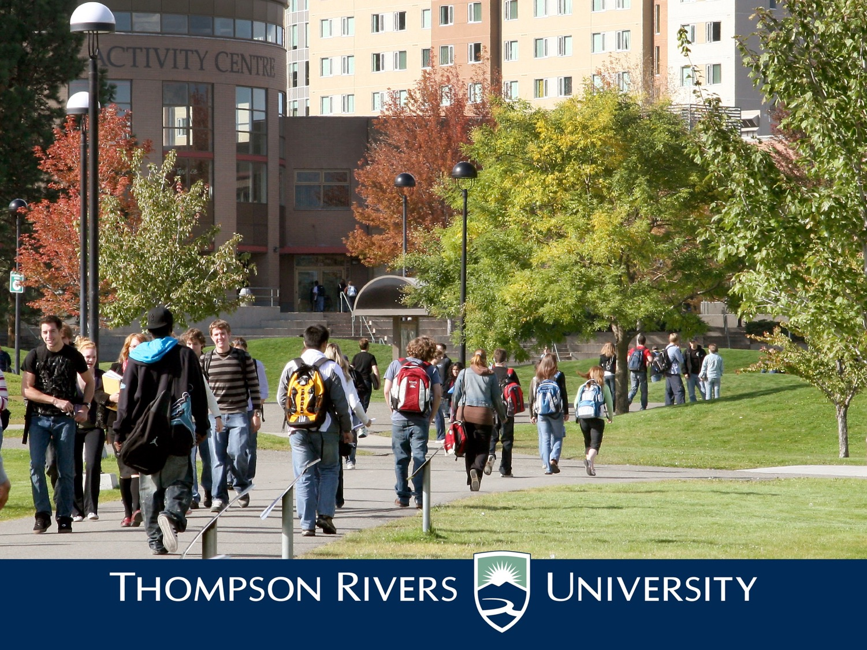

Town Hall – March 9, 2016

Slide 2

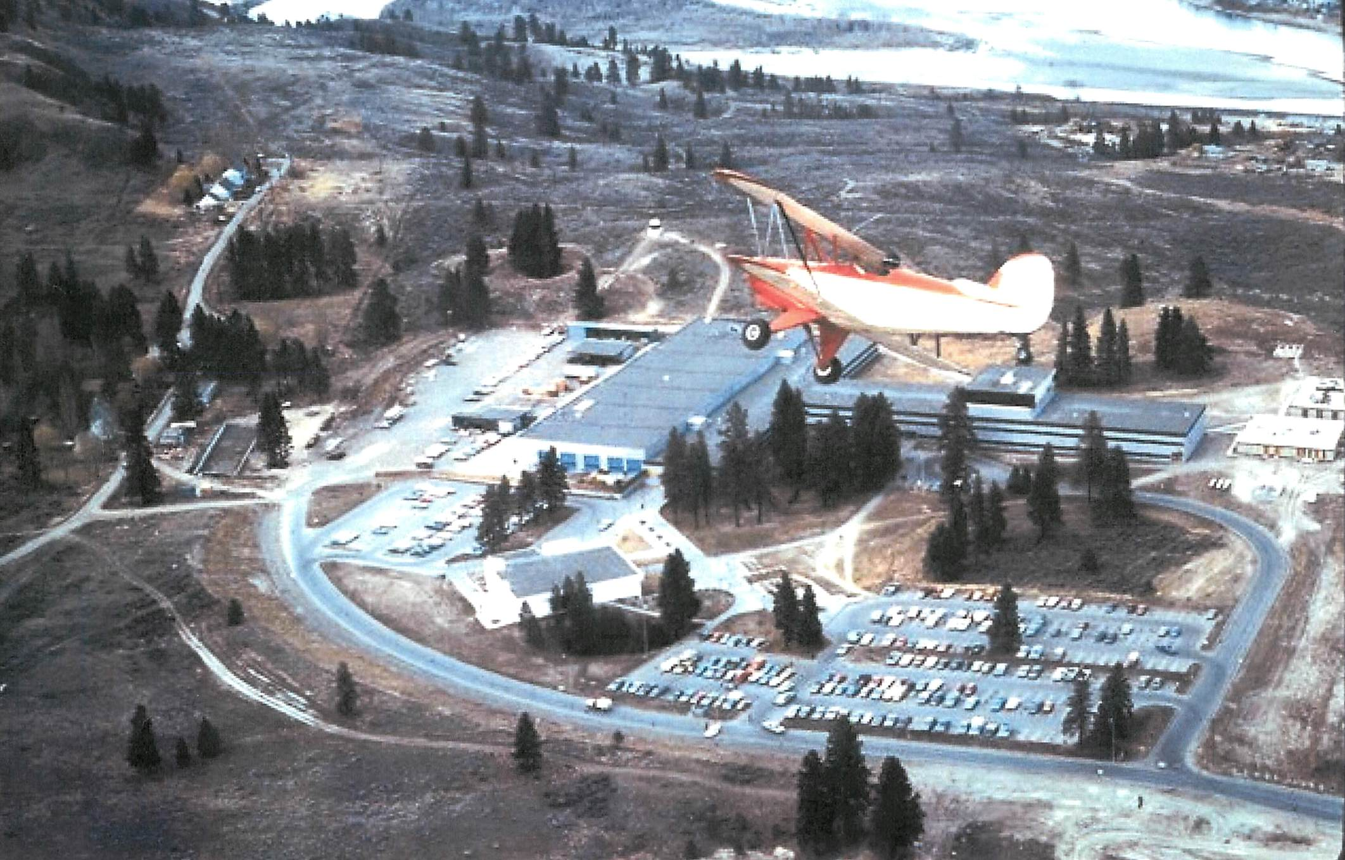
In the beginning: 1974 – 1975*
*Cliff’s Favourite Photo

Slide 3
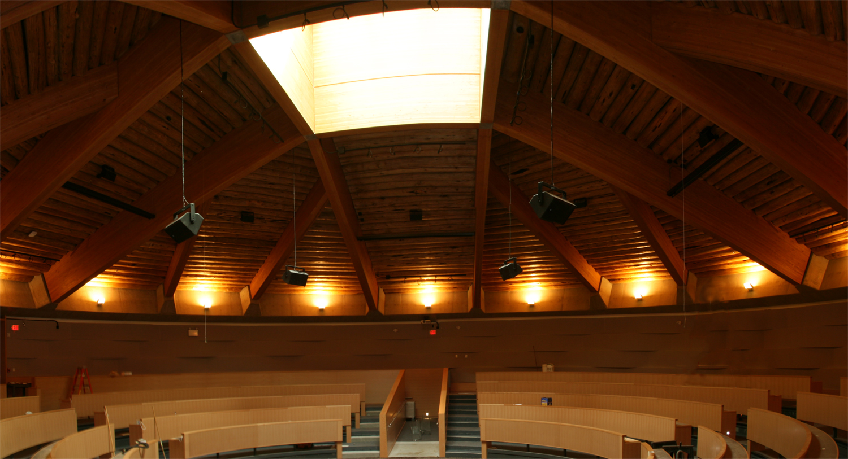
TRU Planning History
1991 Campus Master Plan
2002 McGill Corridor Plan
2003 Revised Campus Master Plan
2008 Rezoning
2010 Hillside Drive Extension and Northgate Extension

Slide 4
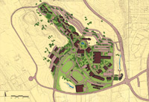
1991 Campus Master Plan
Major Milestones
A new centre of Campus (In 1991 there were no buildings west of the Old Main)
Westgate as a major entrance
Building design and colour guidelines
The ring road
Reuse and repurpose buildings including the relocation
of the Trades and Technology location
1991

Slide 5
2003 CAMPUS MASTER PLAN
http://www.tru.ca/vpadmin/campusplan.html
The mandate included:
• Market scan of similar institutions.
• Develop 10,000/13,000/16,000 student population tactical scenarios.
• Recommendations regarding long term development strategy.
• Update 1991 Campus Plan design guidelines.
• Develop landscape guidelines.
2003

Slide 6
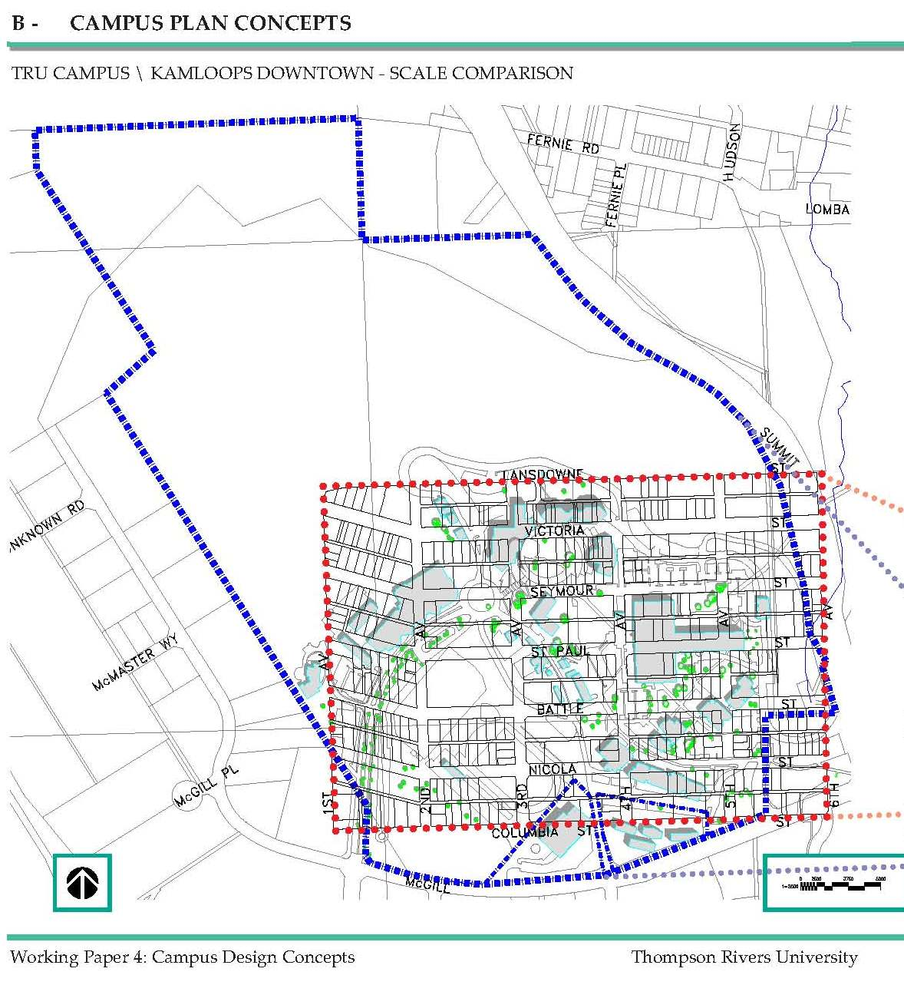
CAMPUS PLAN MAJOR CONCEPT: DENSITY
2003

Slide 7
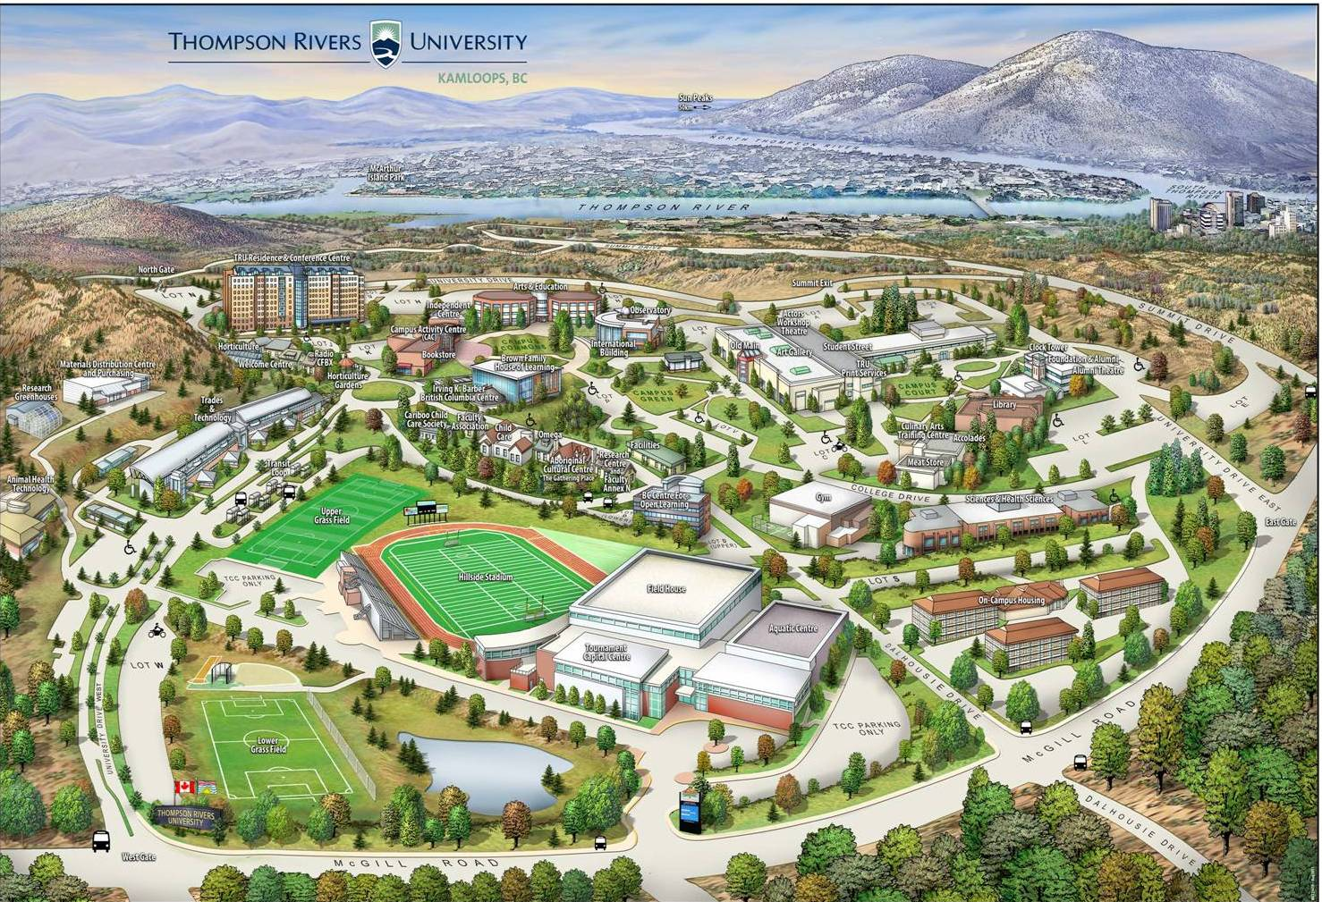
Academic and Recreational Core

Slide 8
TRU’s REZONING APPLICATION
2008
Created a new Post Secondary Education zone (P8)
PERMITTED USES
Universities, colleges
Vocational and technical schools
Office commercial to be permitted subject to Section 1403
Multiple family residential subject to Division Twenty-Nine, RM-2
(Multiple Family - Medium Density)
2008

Slide 9
PERMITTED ACCESSORY USES
Assembly hall
Church
Conference services
Daycare facility
Emergency and protective services
Entertainment facility
Hotel accommodation to be permitted subject to Section 1404
Library
Museum
Neighbourhood convenience store
Neighbourhood pub
Nightclub/cabaret
Office
Personal service
Private club
Professional practice
Recreation facility (indoor or outdoor)
Restaurant and food service
Retail trade
Student accommodation/dormitory
Trade and technology centre
2008

Slide 10
Now: University Village
Why a University Village?
Enhance campus life for the University’s students, faculty and staff
Add vibrancy to the campus;
    After-hours and weekend activities
    Meeting the needs for commuter students and international students
    Needs identified in student surveys (Food!)
    Student, faculty and staff amenity space
    Other??
Generate revenue for university purposes
    Scholarships
    Bursaries
    Research
2010

Slide 11
TRU Board of Governors acts:
Establishes the legal entity – Thompson Rivers University Community Trust (TRUCT) – December 2011
Appointed the Directors to TRUCT – March 2012
  Six external Directors
  Five internal Directors (Governor from the Board of Governors, President, Vice President Administration and Finance, Faculty representative and Student representative)
2013

Slide 12
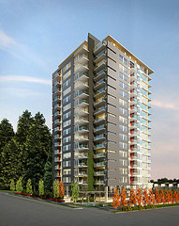
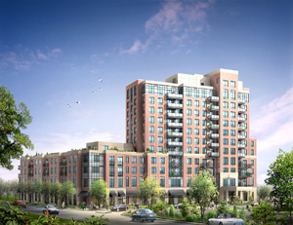
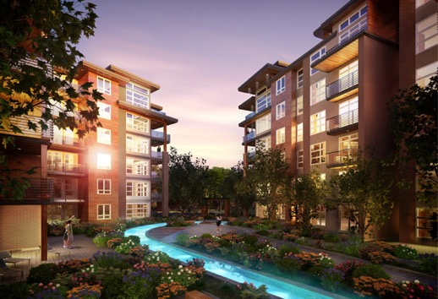
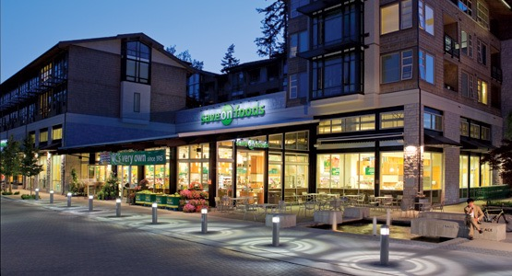
University Village Consultation
Consultation process - stakeholders
  Students, faculty, staff and community
  TRU Community Trust
  TRU Board of Governors
  Developer
• Other
UBC
2013

Slide 13

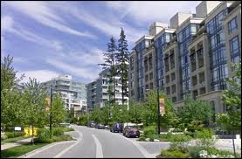
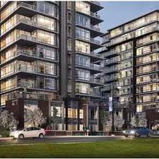
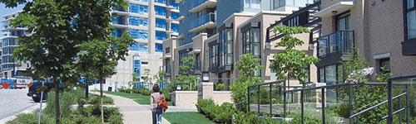
University Village Consultation
What should a University Village include – some ideas
  Retail shops, restaurants, professional offices
  Student incubator space
  Market based housing (strata)
  Student residences
  Other??
SFU
2013

Slide 14
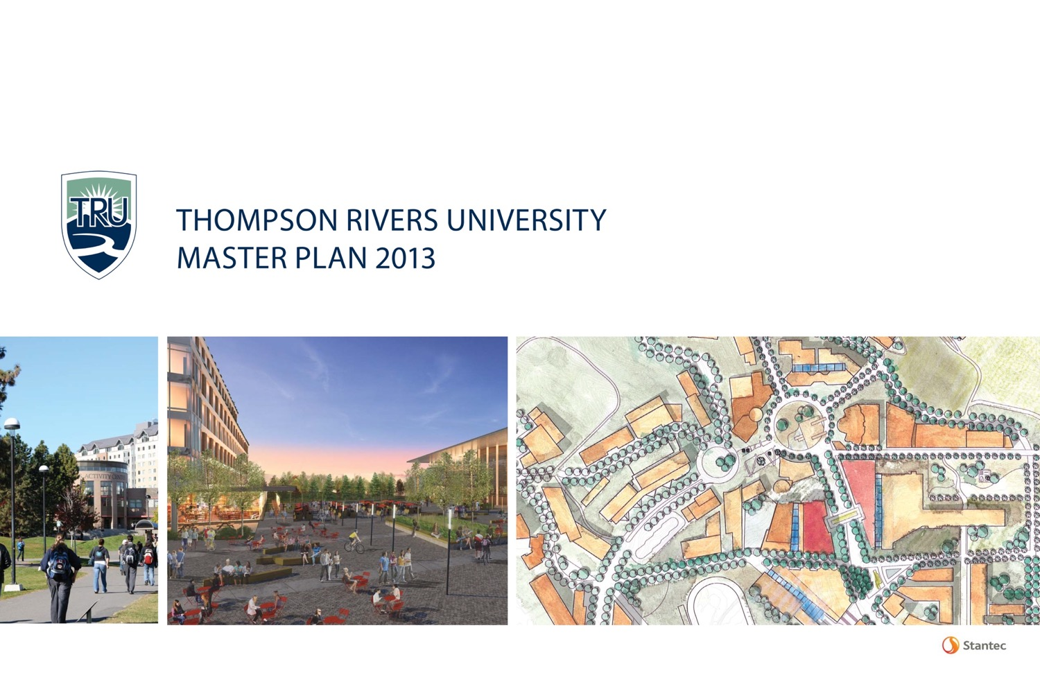
SFU

Slide 15
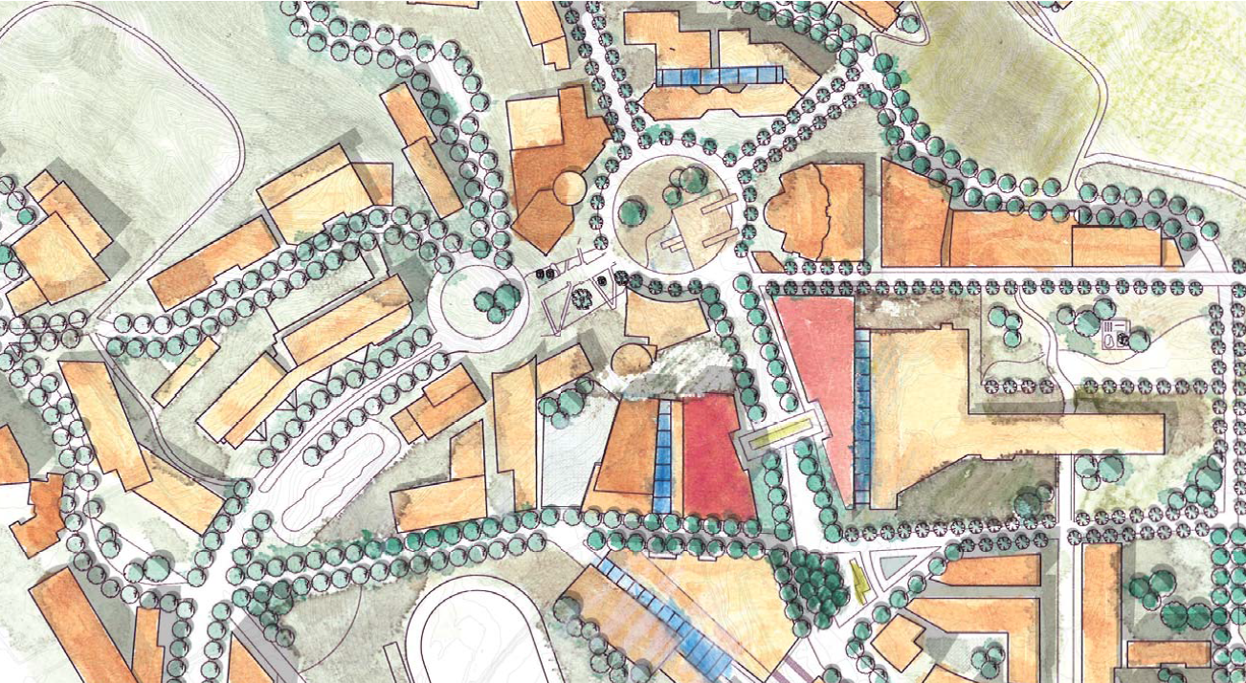
IMPLEMENTING TRU’S MASTER PLAN
Information Session – March 9, 2016

Slide 16
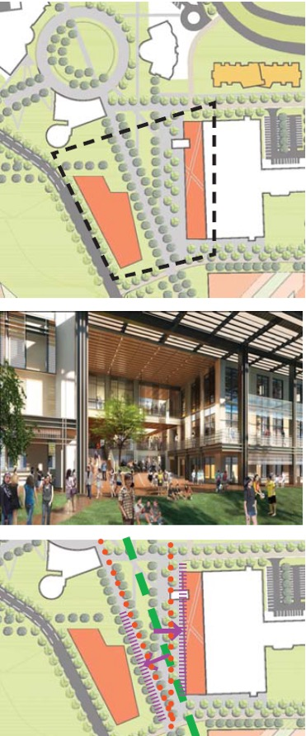
CAMPUS MASTER PLAN 2013 EVOLUTION
Campus Master Plan 2013 – Phase I
- Approved by Board of Governors February 2014
Campus Master Plan 2013 – Phase 2
- Revised Implementation Plan*
- Campus Design and Design Review Guidelines*
- Deep Services Infrastructure Master Plan
- Transportation Demand Study
- Campus Sustainability Framework*
- District Energy Feasibility Study
- Completed February 2015
* Approved by the Board of Governors 2015

Slide 17
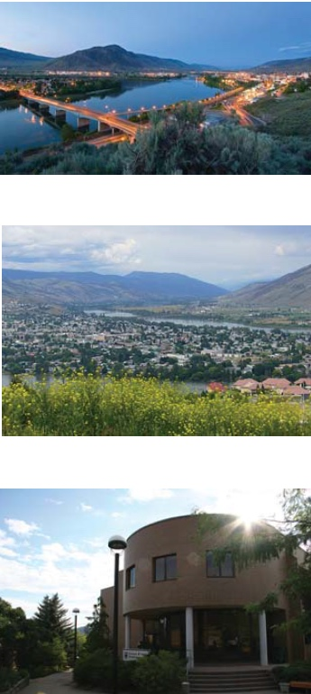
REVISED IMPLEMENTATION PLAN
Refined growth assumptions from 2013 version
Reclassified parcels for additional TRUCT developments without compromising future academic build-out
Eventual replacement of Clock Tower and Library
Minor changes to roadways and pedestrian networks
New proposed academic development in campus heart

Slide 18
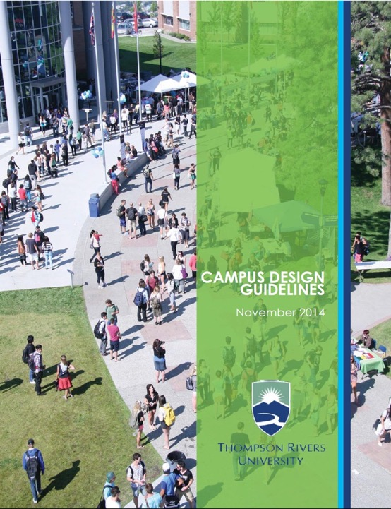
CAMPUS DESIGN &
DESIGN REVIEW GUIDELINES
Define the look and feel of our campus
Guidelines that define districts, public realm, building specifications and sustainability requirements
Provide a process by which the University can evaluate the quality and “integratablity” of built form proposals
Loosely based on SFU’s UniverCity design guidelines
Positively received by TRUCT Board of Directors
Approved by the Board of Governors February 2015

Slide 19
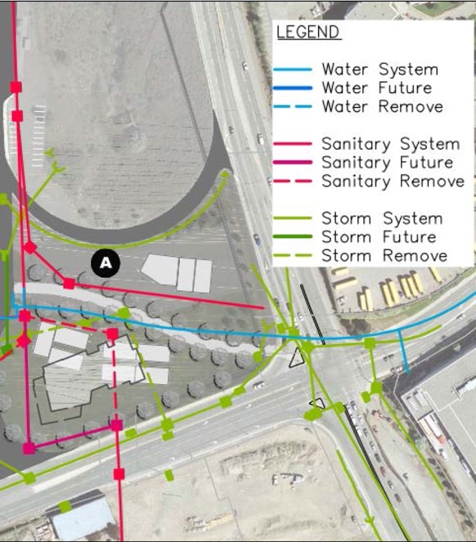
DEEP SERVICES STUDY
Specifies location and condition of existing campus infrastructure with recommendations
Examined water supply, storm sewer, sanitary sewer, electrical and communications infrastructure
Outlined limitations and constraints of future buildable parcels
Complimented with GIS mapping

Slide 20
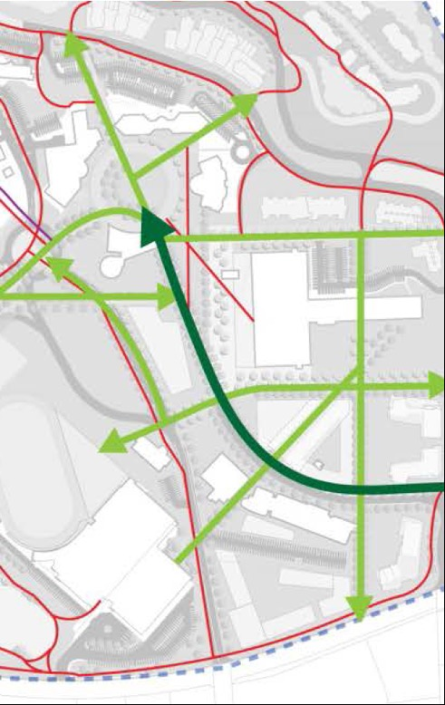
TRANSPORTATION DEMAND STUDY
Examined existing conditions related to travel patterns, pedestrian and cycling network, transit network and parking supply
Identified impacts related to campus master plan develops
Provides a series of phased recommendations for transit, parking, and the pedestrian and cycling network as the campus master plan is built out

Slide 21
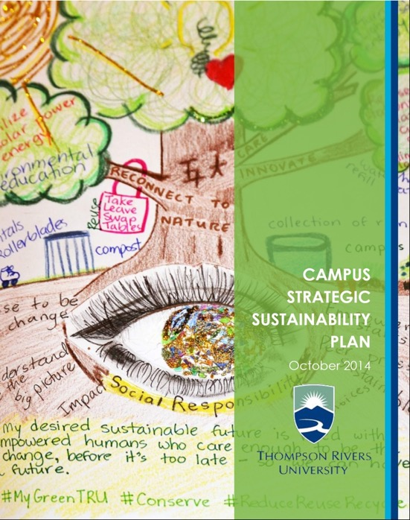
STRATEGIC SUSTAINABILITY PLAN
Roadmap to campus sustainability and STARS Platinum
4 overarching goals: operations and planning; advocacy and engagement; learning; and administration
36 separate measurable outcomes under these 4 goals
Campus design guidelines adheres to the campus sustainability plan
Approved by the Board of Governors November 2014

Slide 22
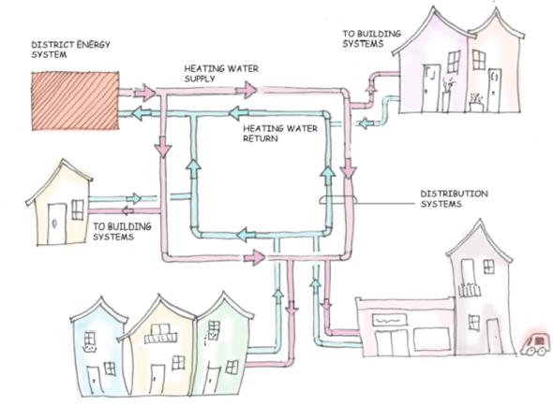
DISTRICT ENERGY FEASIBILITY STUDY
Study to determine the feasibility of connecting all campus infrastructure to a common utility plant
Total campus district energy system deemed unfeasible but makes a number of recommendations with respect to localized and distributed geothermal system and biomass boilers for heating loads
Possible inclusion of TRUCT developments in future district energy system applications

Slide 23
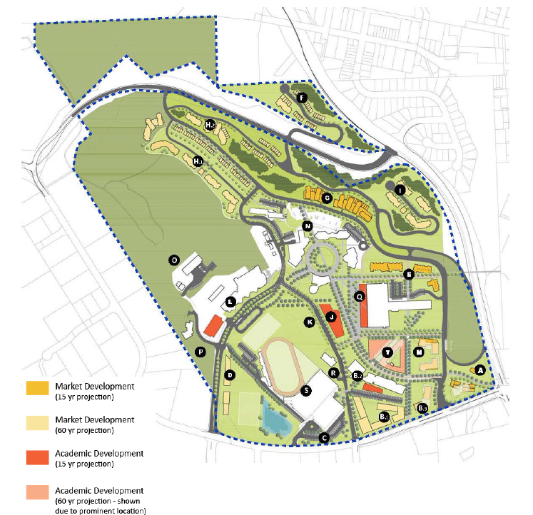
ESTIMATED BUILD-OUT TIMELINE

Slide 24
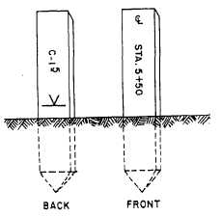
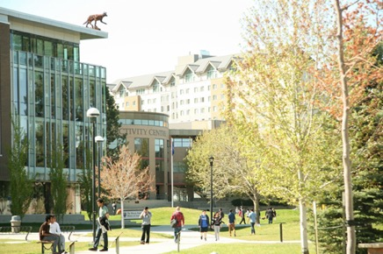
REZONING TRU
Land is currently being surveyed for the lease between TRU/TRUCT and for rezoning purposes
In March 2016, TRU will apply for an adjustment to the zoning that is currently in place
TRUCT is TRU’s agent in the rezoning process
TRUCT has engaged Coriolis Consulting to advise and assist in the rezoning process
Rezoning application does not request any new uses for these lands but rather seeks to consolidate the current zoning to allow for more office-use in the main campus entrance area

Slide 25
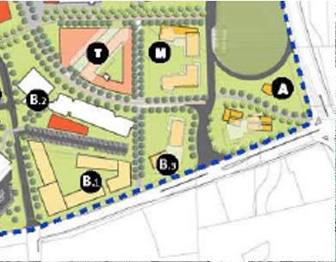
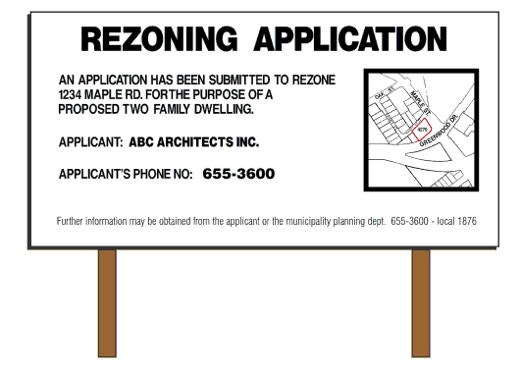
REZONING TRU
TRU/TRUCT would like to amalgamate the zoning in place in order to permit higher density office-use in two key areas adjacent to the main campus entrance
This Application is consistent with the TRU Campus Master Plan as well as the interests expressed by stakeholders who participated in this planning process over the past decade.
As part of the Zoning Application Process, the public will be notified of this Application through zoning application signs posted in the applicable areas and through a Public Information Session hosted by the City of Kamloops.
`
`
AN APPLICATION HAS BEEN SUBMITTED TO
REZONE <<ADRESS>> FOR THE PURPOSE OF
<<STATE PURPOSE>>
APPLICANT: TRU
APPLCANT’S PHONE NO: 250-828-5000

Slide 26
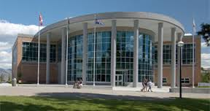
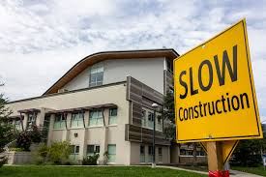
REZONING TRU
The City of Kamloops and the TRU community are important partners in making sure the plans for development on university lands serve not only the TRU Community, but also the broader community in Kamloops
For more information about the Zoning Application, or to view the Application in its entirety, please visit the TRUCT Offices or contact the office directly

Slide 27
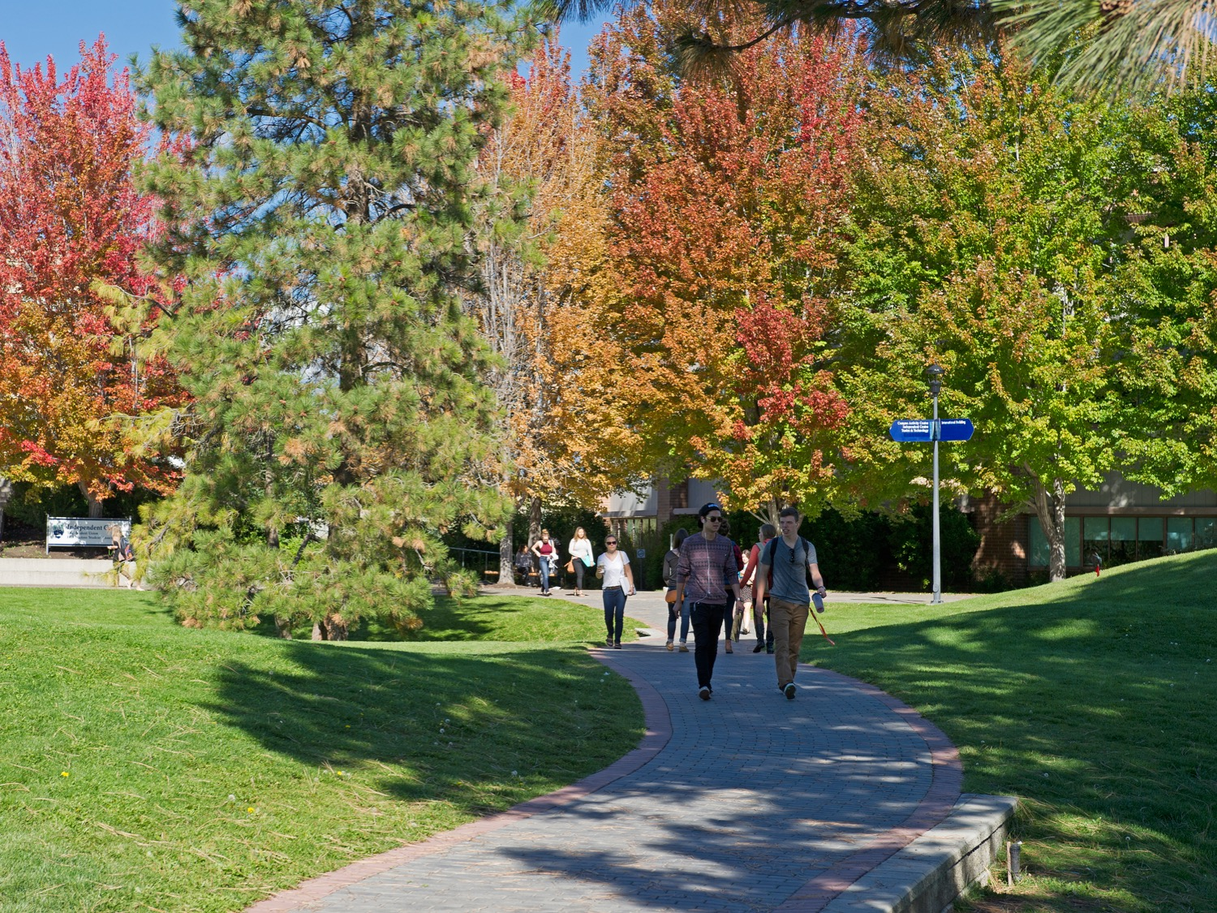
Questions?

